Slide 1

SMART INDIA HACKATHON 2026
TITLE PAGE
Problem Statement ID – SIH26102
Problem Statement Title- AI Detection of Anomalies, Fraud & Inefficiencies in MPLAD Scheme Implementation
Theme- Government & Public Services
PS Category- Software
Team ID- 151360
Team Name- MAITRI

Slide 2

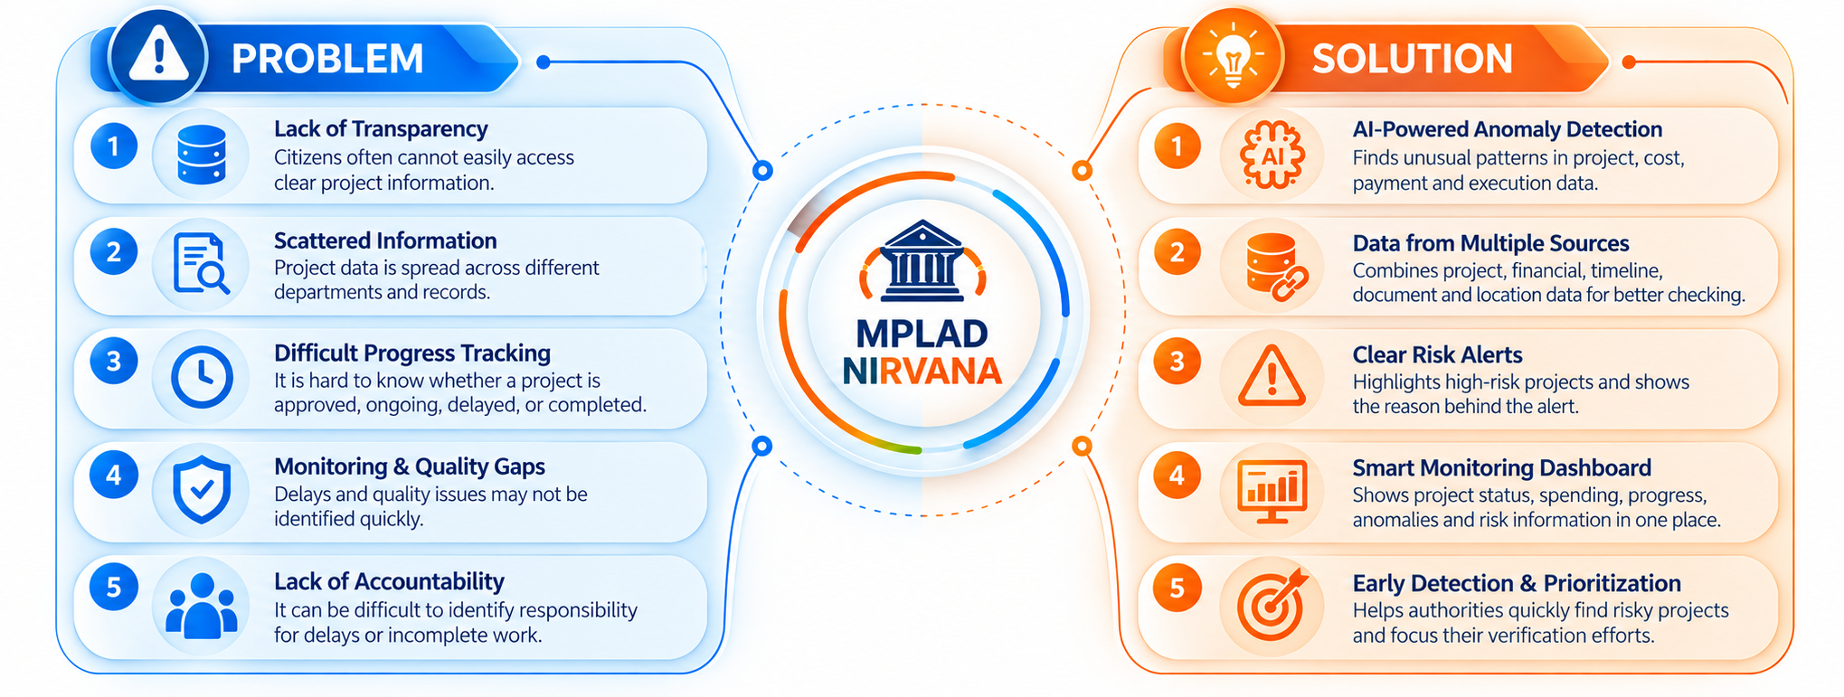

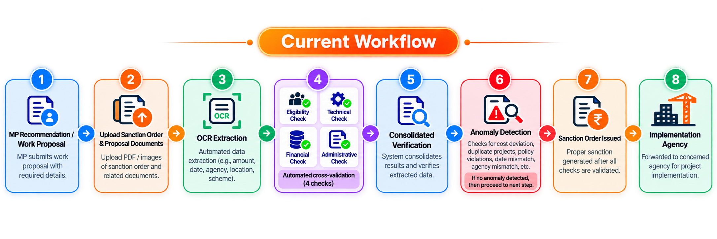
AI-POWERED ANOMALY DETECTION SYSTEM FOR MPLAD SCHEME
MAITRI

Slide 3
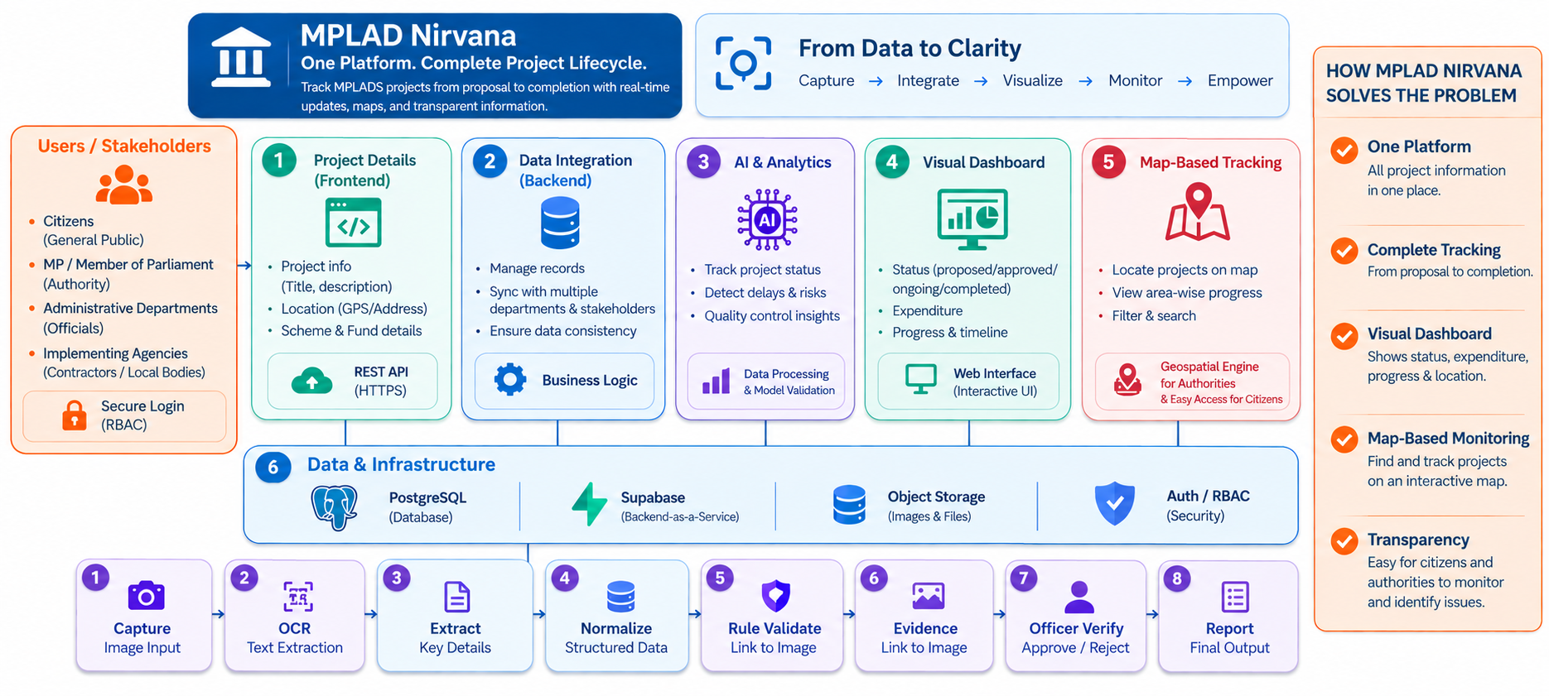
TECHNICAL APPROACH
MAITRI
Mongo-DB

Slide 4
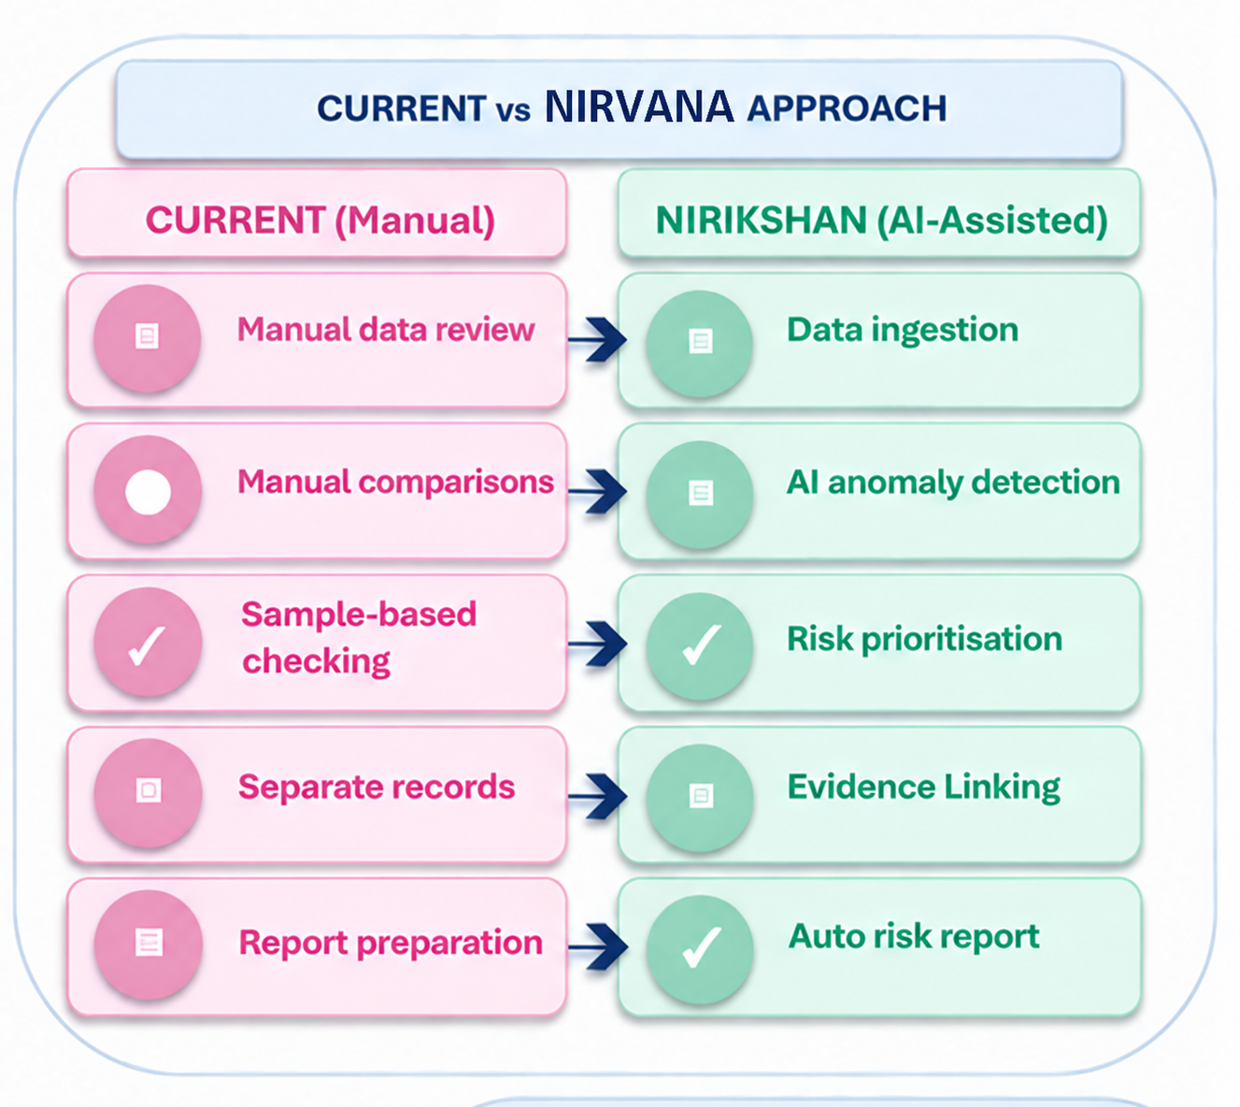
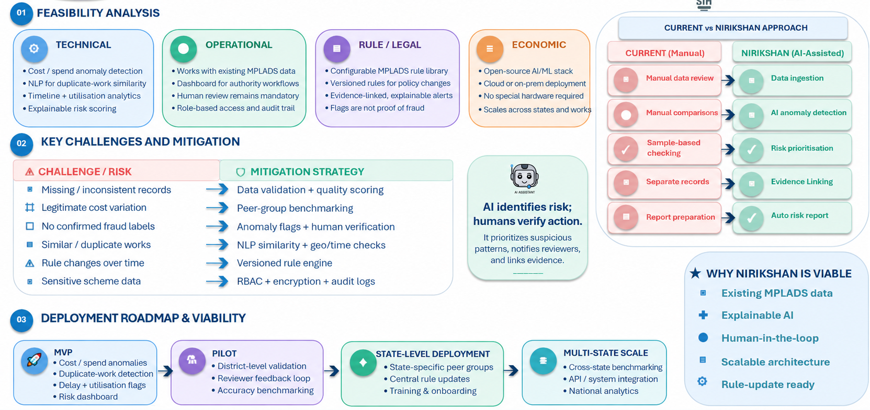
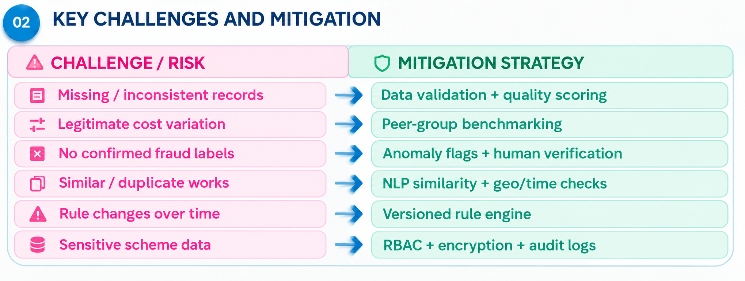

FEASIBILITY AND VIABILITY
MAITRI
NIRVANA
NIRVANA

Slide 5
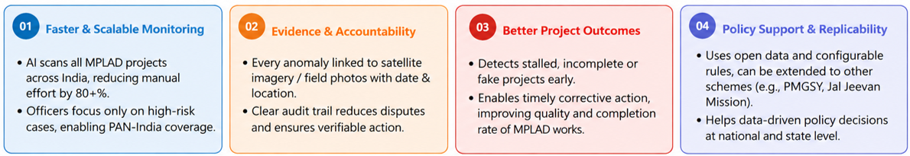
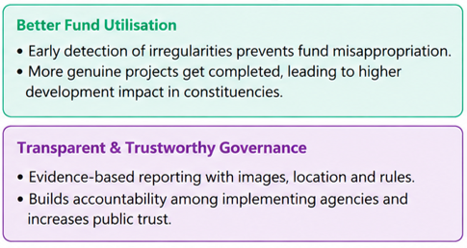
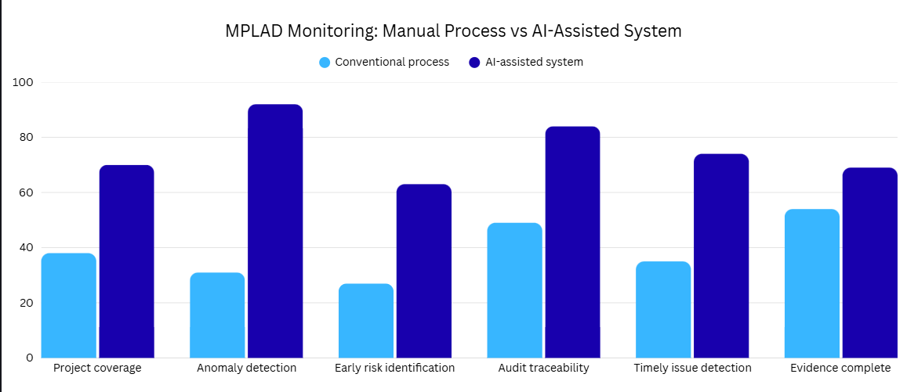
IMPACT AND BENEFITS
MAITRI
%
%
%
%
%
%

Slide 6
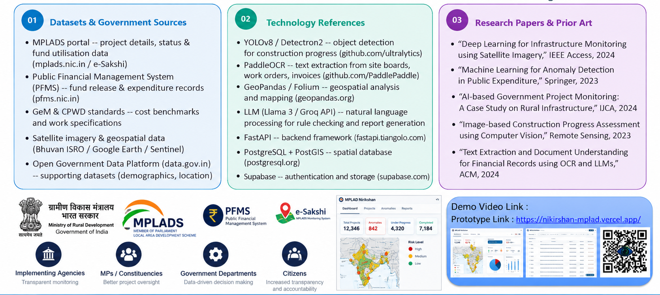

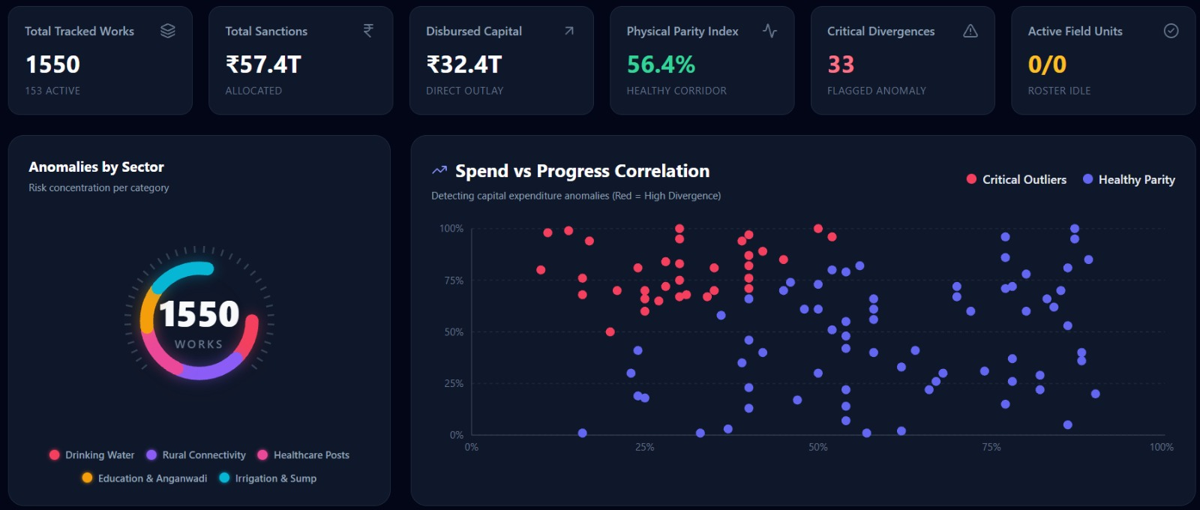
RESEARCH AND REFERENCES
MAITRI

